Slide 1

NETA PowerPoint® Slides
to Accompany
Prepared by
Katharine Ferguson,
Seneca College

Slide 2
Revising Business Messages
Chapter 6

Slide 3
Revising Business Messages
Revising tips
Improving
clarity
Proofreading
Evaluating
Notes:
Revising means improving the content and sentence structure of your message. Proofreading involves correcting the grammar, spelling, punctuation, format, and mechanics. Evaluating is the process of analyzing whether your message achieved its purpose.

Slide 4
Revise for Clarity, Conciseness, and Readability
www.youtube.com/watch?v=asZEojIh-gg
Notes:
“Cliché Bingo: a song with 86 business buzzwords and clichés”: The video is funny and drives home the issues of clarity and cliché use. It is especially useful in helping students for whom English is an additional language become familiar with clichés. Ask students how many of these clichés they use.

Slide 5
Stopping to Revise: Applying Phase 3 of the 3-x-3 Writing Process
Look for ways to shorten the message.
Remove excessive expressions.
Omit long lead-ins.
Purge there is/are and it is/was fillers.
Reject redundancies.
Edit empty words.
Write concisely for microblogging on social networks.

Slide 6
Removing Excessive Expressions
Excessive
Concise
As a general rule
At a later date
At this point in time
Despite the fact that
Due to the fact that
Feel free to
In the event that
Until such time as
With regard to
Generally
Later
Now; presently
Although
Because
Please
If
Until
About
Notes:
When revising, focus on eliminating flabby expressions. Many flabby expressions can be shortened to one concise word.

Slide 7
Omitting Long Lead-Ins
Delete unnecessary introductory words.
Wordy: We are sending this announcement to let everyone know that we expect to change Internet service providers within six weeks.
Concise: We expect to change Internet service providers within six weeks.
Notes:
Long lead-ins delay getting to the meat of the sentence.

Slide 8
Purging Unnecessary Fillers
Avoid wordiness.
Wordy: There are more women than men enrolled in college today.
Concise: More women than men are enrolled in college today.
Notes:
In many sentences, the expressions there is/are and it is/was are unnecessary fillers. They take up space and delay getting to the point of the sentence.

Slide 9
Rejecting Redundancies
Say it once.
Redundant
Adequately essential
Combined together
Each and every
New beginning
Refer back
Concise
Essential
Combines
Each; every
Beginning
Refer
Notes:
Expressions that repeat meaning or include unnecessary words are redundant. Excessive adjectives, adverbs, and phrases often create redundancies and wordiness. Redundancies do not add emphasis. They identify a writer as inexperienced.

Slide 10
Editing Empty Words
Unclutter your sentences.
In the case of Twitter, it increased users but lost share value.
We are aware of the fact that new products soar when pushed by social networking.
She chose a career in a field that was analytical in nature.
Notes:
Good writers avoid saying what is obvious. Be alert to these empty words: case, degree, the fact that, factor, instance, nature, and quality. Avoid saying the obvious; omit unnecessary words. Look carefully at clauses beginning with that, which, and who. They can often be shortened without loss of clarity. Search for phrases such as it appears that. These phrases often can be reduced to a single adjective or adverb, such as apparently.

Slide 11
Purge Empty Words (cont.)
Unclutter your sentences.
In the case of Twitter it increased users but lost share value.
We are aware of the fact that new products soar when pushed by social networking.
She chose a career in a field that was analytical in nature.

Slide 12
Make Your Message Clear
Keep it short and simple.
Dump trite “business” phrases.
Drop clichés and slang.
Avoid slang and buzzwords.
Rescue buried verbs.
Control exuberance.

Slide 13
Microblogging and Conciseness
Companies are using microblogging to make announcements, promote goodwill, and sell their products.
Enterprise microblogging enables companies to use special platforms to collaborate, share information, and communicate privately within their organization.

Slide 14
Microblogging and Conciseness
Regardless of the microblogging platform, conciseness is critical.
Messages must be short.
Messages should not stray too far from conventional spelling, grammar, and punctuation.
Notes:
Refer to sample tweets on page 136.

Slide 15
Writing Concise, Effective Tweets
Include only main ideas focused on useful information.
Choose descriptive but short words.
Personalize your message if possible.
Be prepared to draft several versions when striving for conciseness, clarity, and correctness.

Slide 16
Keep It Short and Simple
Wordy and Unclear
Improved
Employees have not been made sufficiently aware of the potentially adverse consequences regarding the use of these perilous chemicals.
Warn your employees about these dangerous chemicals.
Notes:
Strive for clarity. The goal in business is to express, not to impress. To achieve clarity, remember KISS: Keep it short and simple.

Slide 17
Slashing Trite Business Phrases
Use fresher, more original phrases.
Wordy and Unclear
Improved
As per your request
Enclosed please find
Every effort will be made
In receipt of
Please do not hesitate to
With reference to
Thank you in advance
As you requested
Enclosed is
We’ll try
Have received
Please
About
Thank you
Notes:
To sound businesslike, many writers repeat the same stale expressions that other writers have used over the years. To make writing sound more vigorous and fresher, eliminate these trite phrases or find more original ways to convey the idea.

Slide 18
Cutting Clichés
Clichéd expressions
Have become exhausted by overuse
Lack freshness and clarity
Examples:
Last but not least
Better than new
Stand your ground
Think outside the box
Make a bundle
Notes:
There are additional examples on page 138. Ask students to come up with others they may have heard and used.

Slide 19
Slang and Buzzwords
Slang is composed of informal words with arbitrary and extravagantly changed meaning (e.g., snarky, lousy, getting burned).
Buzzwords are technical expressions that have become fashionable and are often meant to impress rather than express (e.g., optimize, impactful, innovative, leveraging, utilize, and paradigm shift), and vague terms like cost effective, positioned to perform, solution oriented.

Slide 20
Slang and Buzzwords
Consider this statement:
“The Administration has an awful lot of other things in the pipeline, and this has more wiggle room so they just moved it to the back burner. However, the proposal might be offered again since there is no pulling back because of the hot-potato factors.”
What does this statement mean?
Notes:
This statement could generate some interesting discussion. Consider having students work in teams of three to rewrite the statement by using conventional words and removing the slang and buzzwords.

Slide 21
Rescuing Buried Verbs
Buried Verbs
Unburied Verbs
Conduct a discussion of
Give consideration to
Make an assumption of
Perform an analysis
Reach a conclusion that
Engage in the preparation of
Discuss
Consider
Assume
Analyze
Conclude
Prepare
Notes:
Buried verbs are those that are needlessly converted to wordy noun expressions. This happens when such verbs as acquire, establish, and develop are made into nouns such as acquisition, establishment, and development. Using these nouns increases sentence length, drains verb strength, slows the reader, and muddies thought.

Slide 22
Eliminating Intensifiers
Control your enthusiasm and guard against excessive use.
Excessive Exuberance Businesslike
We totally agree that we We agree that we did
actually did not give his not give his proposal a
proposal a very fair fair trial.
trial.
Notes:
Overuse of words such as very, definitely, quite, completely, extremely, really, actually, and totally sounds unbusinesslike. Control enthusiasm and guard against excessive use.

Slide 23
Proofreading to Catch Errors
Spelling
Format
Grammar
Proofreading
Names and numbers
Punctuation

Slide 24
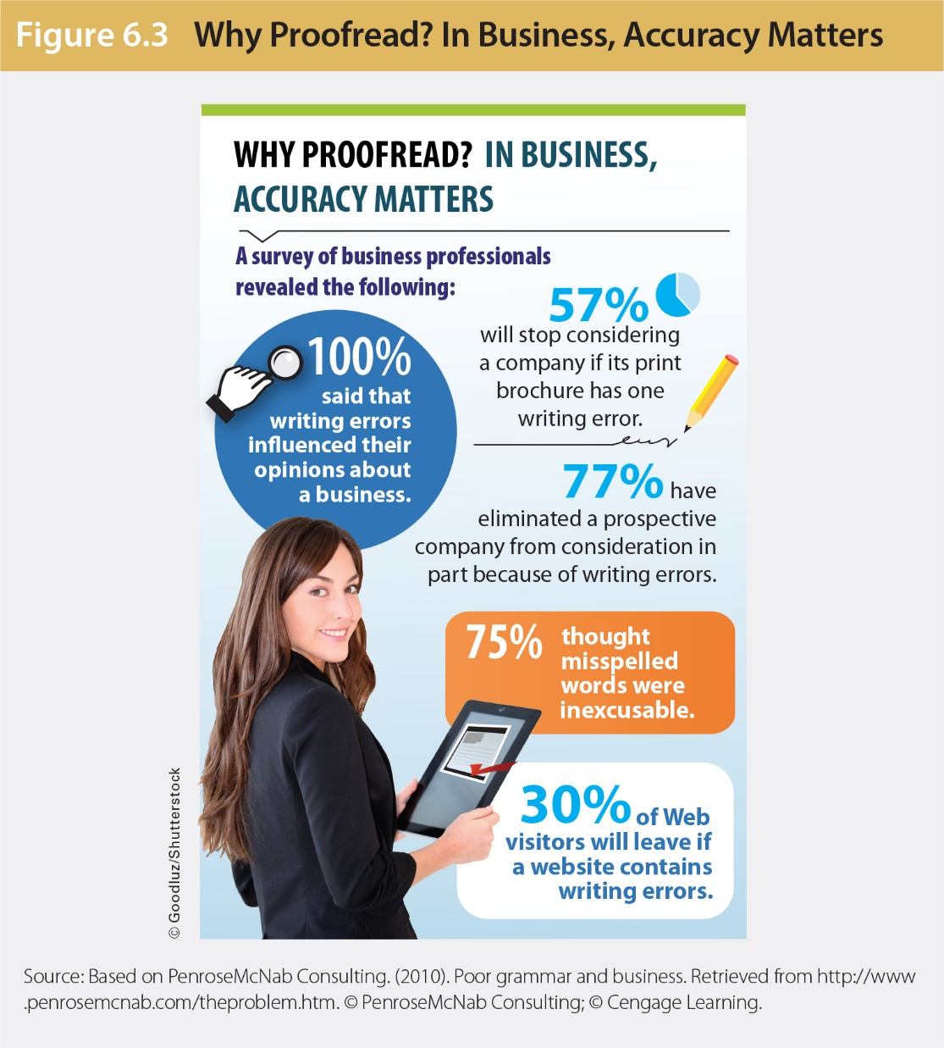
Why Proofreading Matters

Slide 25
What to Watch for in Proofreading
Spelling
Grammar
Punctuation
Names and numbers
Format
Notes:
Format: be sure the document looks balanced on the page.

Slide 26
How to Proofread Complex Documents
Print a copy, preferably double-spaced, and set it aside for at least a day.
Allow adequate time for careful proofreading.
Be prepared to find errors.
Read the message at least twice—once for meaning and once for grammar/mechanics.

Slide 27
How to Proofread Complex Documents
Reduce your reading speed. Concentrate on individual words.
For documents that must be perfect, enlist a proofreading buddy.
Use standard proofreading marks shown on the inside front cover to indicate changes.

Slide 28
How to Edit Team Writing
Begin with a positive statement. What can you praise?
Be specific in explaining what you don’t understand.
Ensure the material is logically organized.
Make suggestions to improve specific areas.
Make polite statements (e.g., I would suggest … , You might consider … , How about doing this …?).

Slide 29
Evaluating the Effectiveness of Your Message
Is the message polished and clear enough to convince a reader you are worth listening to?
How successful will the message be?
Does it say what you want it to?
Will it achieve your purpose?
How will you know if it succeeds?
Notes:
The best way to judge the success of your communication is through feedback. Encourage your reader to respond to your message. This feedback will tell you how to modify future efforts to improve your communication technique.

Slide 30
Editing, Proofreading, and Evaluating
Remove excessive expressions.
Avoid opening fillers and long lead-ins.
Reject redundancies.
Tighten your writing.
Write concisely for microblogging.
Keep the message simple.
Slash trite business phrases.

Slide 31
Editing, Proofreading, and Evaluating
Cut clichés or slang.
Rescue buried verbs.
Eliminate intensifiers.
Improve readability through document design.
Proofread for correctness.
Evaluate your final product.

Slide 32
Summary of Learning Objectives
Polish business messages by revising for conciseness.
Improve clarity in business messages.
Recognize proofreading problem areas, and apply effective techniques to catch mistakes.
Evaluate a message to judge effectiveness.

